Slide 1
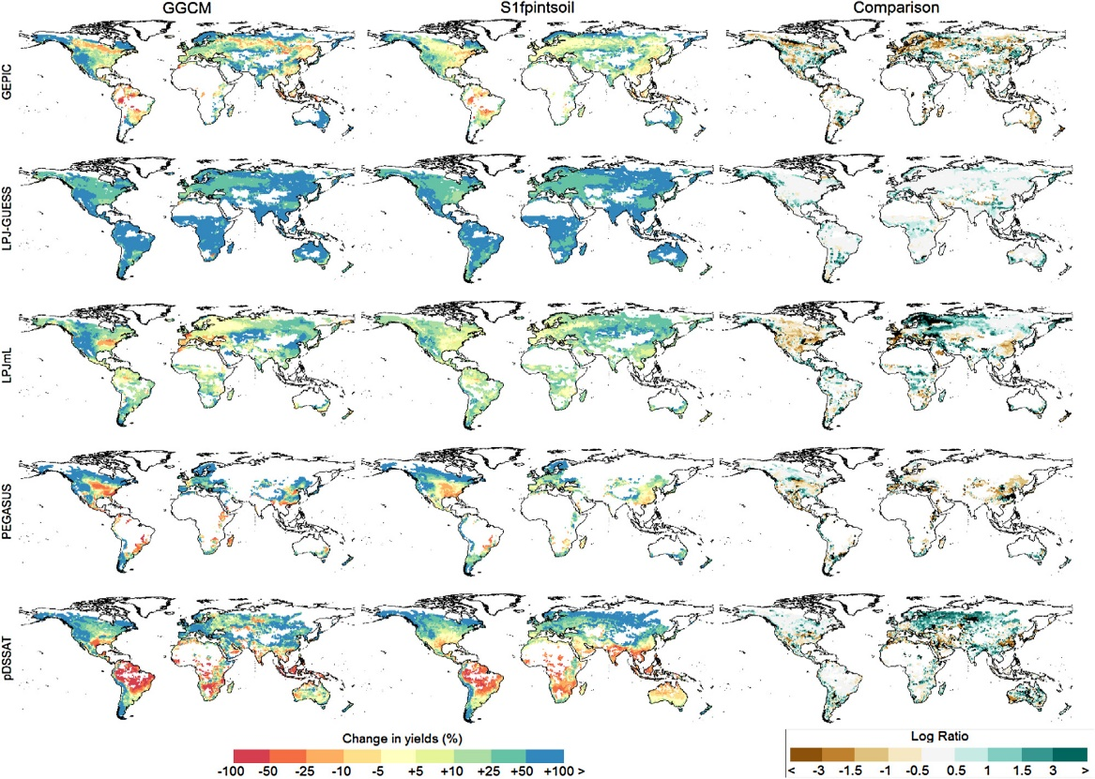
A simpler, faster way to assess the impact of climate change on crop yields
Objective: Develop a reliable, more computationally efficient alternative to globally gridded crop models (GGCMs) that can advance integrated assessment research addressing land-use change.
Findings: Using a suite of statistical models to predict responses of different crop yields to climate change-driven variations in temperature and precipitation, the study found good agreement between predictions from the statistical emulators and GGCMs.
Impact: This method provides a reliable method for incorporating climate effects on crop yields and to study structural uncertainty in land-use change analysis.
Changes in wheat yields from 2000s to 2090s estimated by the statistical emulators (S1fpintsoil specification) and GGCMs and comparison (log ratio).
E. Blanc, 2017: Statistical emulators of maize, rice, soybean and wheat yields from global gridded crop models, Agriculture and Forest Meteorology, doi: http://dx.doi.org/10.1016/j.agrformet.2016.12.022.

